Slide 1

Reorganization of Pegasus Company
Student’s Name
Institutional Affiliation

Slide 2
Introduction and Background Information of Pegasus Company
Pegasus Company is well known for its large scare research and development in the aerospace field.
The primary goal of this firm is to offers convenience services in aerospace platform to ensure it effective and efficiency in the current competitive marketplace.
For many years since the frim was formed, it has always remained competitive and relevant to the field.
However, based on various tabled reports in the department of Human resource, there is a clear evidence that out teams from various departments within the firm does not work towards the same objectives anymore and this has resulted to poor performance of the company.
Hence, as an Internal consultant, with the help of the company, we found the need to restructure the firm for a better tomorrow.
Notes:
Report has indicated that various experts and people within the firm does not work together and everyone is at their on.
This individualism in the firm has resulted to failure to accomplish our goals and hence, poor performance in the outside world.
The administration and leadership of the organization lack good skills in interpersonal communications because of their heavy science background, and they also need leadership training in the form of management and executive development

Slide 3
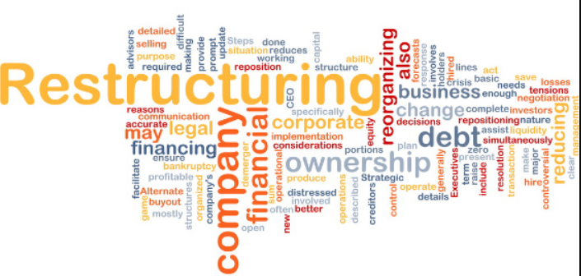
Why do Restructuring?
The firm has various internal issues and poor production due to lack of cooperation among employees.
Basically, company restructuring can be driven by the need for change in organizational structure or due to variety of reasons as follows:
Lack of good leadership, communication and process skills.
To concentrate on key products or accounts
To incorporate new technology
To make better use of talent
To improve competitive advantage
To spin off a subsidiary company
To merge with another company
Notes:
Corporate restructuring can be driven by the necessity to make financial adjustments to its assets and liabilities.
The main cause of failure of Pegasus firm is lack of good leadership, communication and process skills. Therefore, as the lead internal consultant, I will pay close attention on the three areas to ensure the firm gets back to where it started.

Slide 4
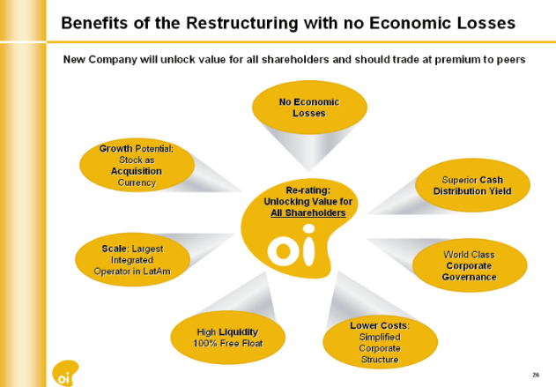
Benefits of Restructuring a Company.
There re many benefits of restructuring and reorganizing an organization.
Some of them includes;
Reviving and declining business
Increasing company’s value
Transfer to the next level or generation
Gaining competitive advantage.
Survival and success in various fields.
Improvement in communication, process and leadership skills.
Notes:
Just as there are many reasons companies might restructure, there are million reasons for reorganizing a firm (Harris & Ng, 2019).
However, even before restructuring a firm, its important to have an excellent planning process with a goal at the end which needs to be achieved.

Slide 5
What to Concentrate More with During the Process
Improvement of communication skills between leaders and their juniors. Effective communication skills do not come naturally for most leaders and managers.
While initiating my restructuring strategy, I will ensure that all readers have been taught better communication tactics to ensure they improve their skills (Mendes, 2018)..
I will also pay close attention to process and leadership skills.
I will initiate a program within the firm where all leaders will be taking leadership training and classes to give them an opportunity to learn better leadership and communication techniques.
Notes:
Report indicates that many employees feel like the company is disintegrating because of the difficulties in communication which, in turn, makes it more difficult to get the projects completed in a timely manner

Slide 6
Conclusion
For successful restructuring of Pegasus Company, it is essential to ensure that qualified professionals have been engaged and all the process control leaders have the necessary requirements to ensure smooth running of the firm (Ruiz & Coduras, 2015).
By determining what areas to be restructured, identifying weaknesses, creating short and long-term goals and implementing short-term corrective actions, it will be easy to revive the Pegasus Company and make it more competitive that it used to be previously.

Slide 7
References
Harris, J., & Ng, T. (2019). Restructuring: Valuation issues in restructuring. Australian Restructuring Insolvency & Turnaround Association Journal, 31(1), 20.
Mendes, D. M. A. C. D. (2018). The appointment process of trustees in different countries and which factors can predict the success of a company after restructuring processes(Doctoral dissertation).
Ruiz, J., & Coduras, A. (2015). Can company restructuring create a healthier work environment, promote corporate entrepreneurship, and improve productivity?. Journal of Business Research, 68(7), 1466-1467.

